Slide 1

Prescription Evaluation with GPT4 and openFDA
Charlie Sun, Minh Tran

Slide 2

Situation
Notes:
You are a doctor, a patient comes in, after some tests you form a diagnosis. Now you want to prescribe them some medicine. You’ve always prescribed medicine A to patients with this disease, so you plan to do the same to this patient. However, unbeknownst to you, the patient has a rare condition, which will make them react very badly to this medicine. Maybe you have never had patients with this condition before, maybe you are new, maybe a new ingredient has been added to the drug.
If you prescribe the drug, the patient will be put in serious risk

Slide 3




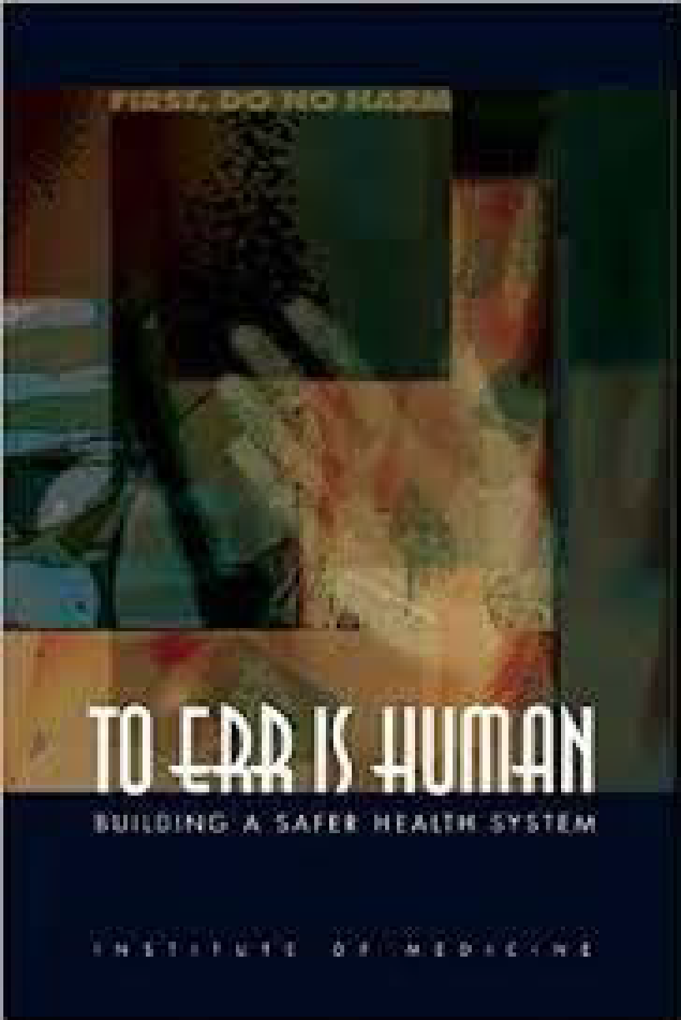
Statistics - Thanks Brian!
2023
1:4 Patients Harmed in Hospitals
2013
210,000 to 440,000 deaths
per year from medical errors
1999
44,000 to 98,000 deaths
per year in U.S. hospitals
from medical errors
2016
250,000+ deaths
per year
from medical errors
2009
195,000 deaths
per year from preventable medical errors
‹#›

Slide 4
Our Idea
Stats
1:4 Patients Harmed in Hospitals, 44% medication-related
Common Errors
dispensing an incorrect medication
miscalculating a dose
failing to identify drug interactions or contraindications
Scope: Prescription checker for healthcare providers, reducing human oversight, complacency and improving effectiveness
Notes:
Quoting the opening slides
Fact 3: Limited supply of doctors in poor and rural areas

Slide 5
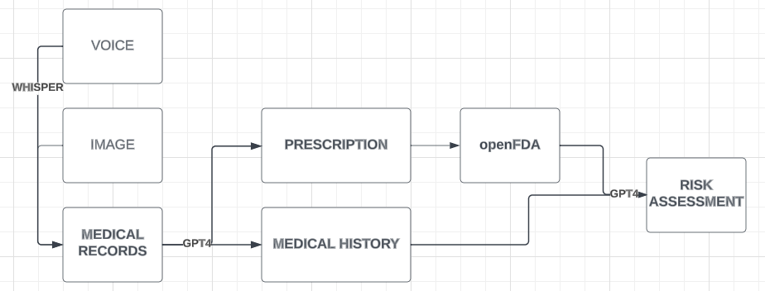
Workflow

Slide 6
Under the Hood
Text Input: patient record and prescription
Info Extraction
Patient’s medical history
Patient’s symptoms and diagnosis
Doctor’s prescription
Fetch drug information from OpenFDA API
Query LLM with combined information (with prompt engineering)
Output: Warnings and evaluation of the treatment’s level of dangerousness
Notes:
Draw a diagram!
Component: Whisper API + Google OCR Language Support (optional include)

Slide 7
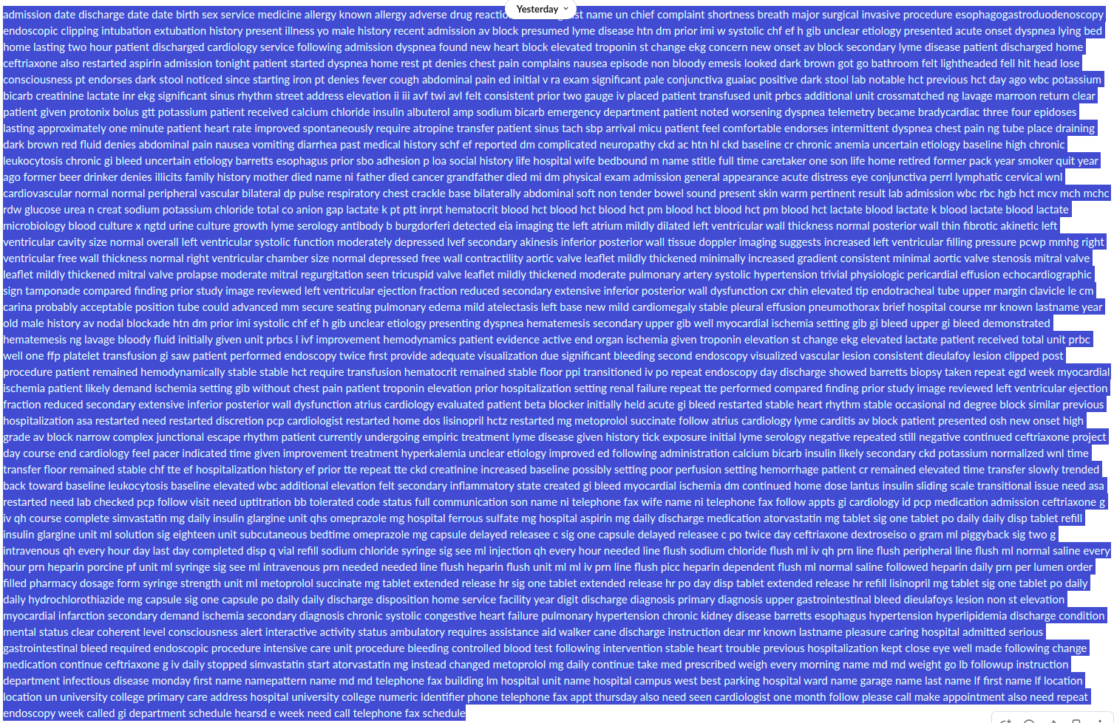
Demo

Slide 8

Demo

Slide 9
Building the Future
Hook 1: Worked efficiently with text (TBD voice and image)
Hook 2: Preliminary experiment on MIMIC-III Public Set
Multimodal - Multi-languages
Voice and Image
Better LLMs
Fine-tuned LLMs
Med-PaLM2, Med-BERT
Reinforcement learning (RLHF)
Like ChatGPT, doctors’ feedback can be used to improve the model
Notes:
Med-PaLM2 (for better LLM that specializes in medical knowledge, >80% on MD exam)
RLHF (reinforcement learning with human feedback): improve the model from doctor feedbacks through reinforcement learning, much like how ChatGPT is improved
Outro: Those are real people with hope, dream, love ones. Let’s try a world that you want your people live in.

Slide 10
Statistics - Thanks Brian!
2023
1:4 Patients Harmed in Hospitals
2013
210,000 to 440,000 deaths
per year from medical errors
1999
44,000 to 98,000 deaths
per year in U.S. hospitals
from medical errors
2016
250,000+ deaths
per year
from medical errors
2009
195,000 deaths
per year from preventable medical errors
‹#›

Slide 11
Thank you!

Slide 12
References
https://www.google.com/url?sa=i&url=https%3A%2F%2Fhealth.clevelandclinic.org%2Fwhy-you-need-an-annual-physical-and-what-to-expect%2F&psig=AOvVaw1WpQjBDf5T10-XXSAY-FwM&ust=1694997171072000&source=images&cd=vfe&opi=89978449&ved=0CBEQjhxqFwoTCIDsnNWysIEDFQAAAAAdAAAAABAD
https://docs.google.com/presentation/d/113zp8asfJnokNKdZ9xP__vJKT31fFfck8SPFyfMmgDU/edit#slide=id.g27e91a21c22_0_188
https://www.amcp.org/about/managed-care-pharmacy-101/concepts-managed-care-pharmacy/medication-errors#:~:text=The%20three%20most%20common%20dispensing,identify%20drug%20interactions%20or%20contraindications.
https://www.ruralhealthinfo.org/topics/healthcare-access

